Slide 1


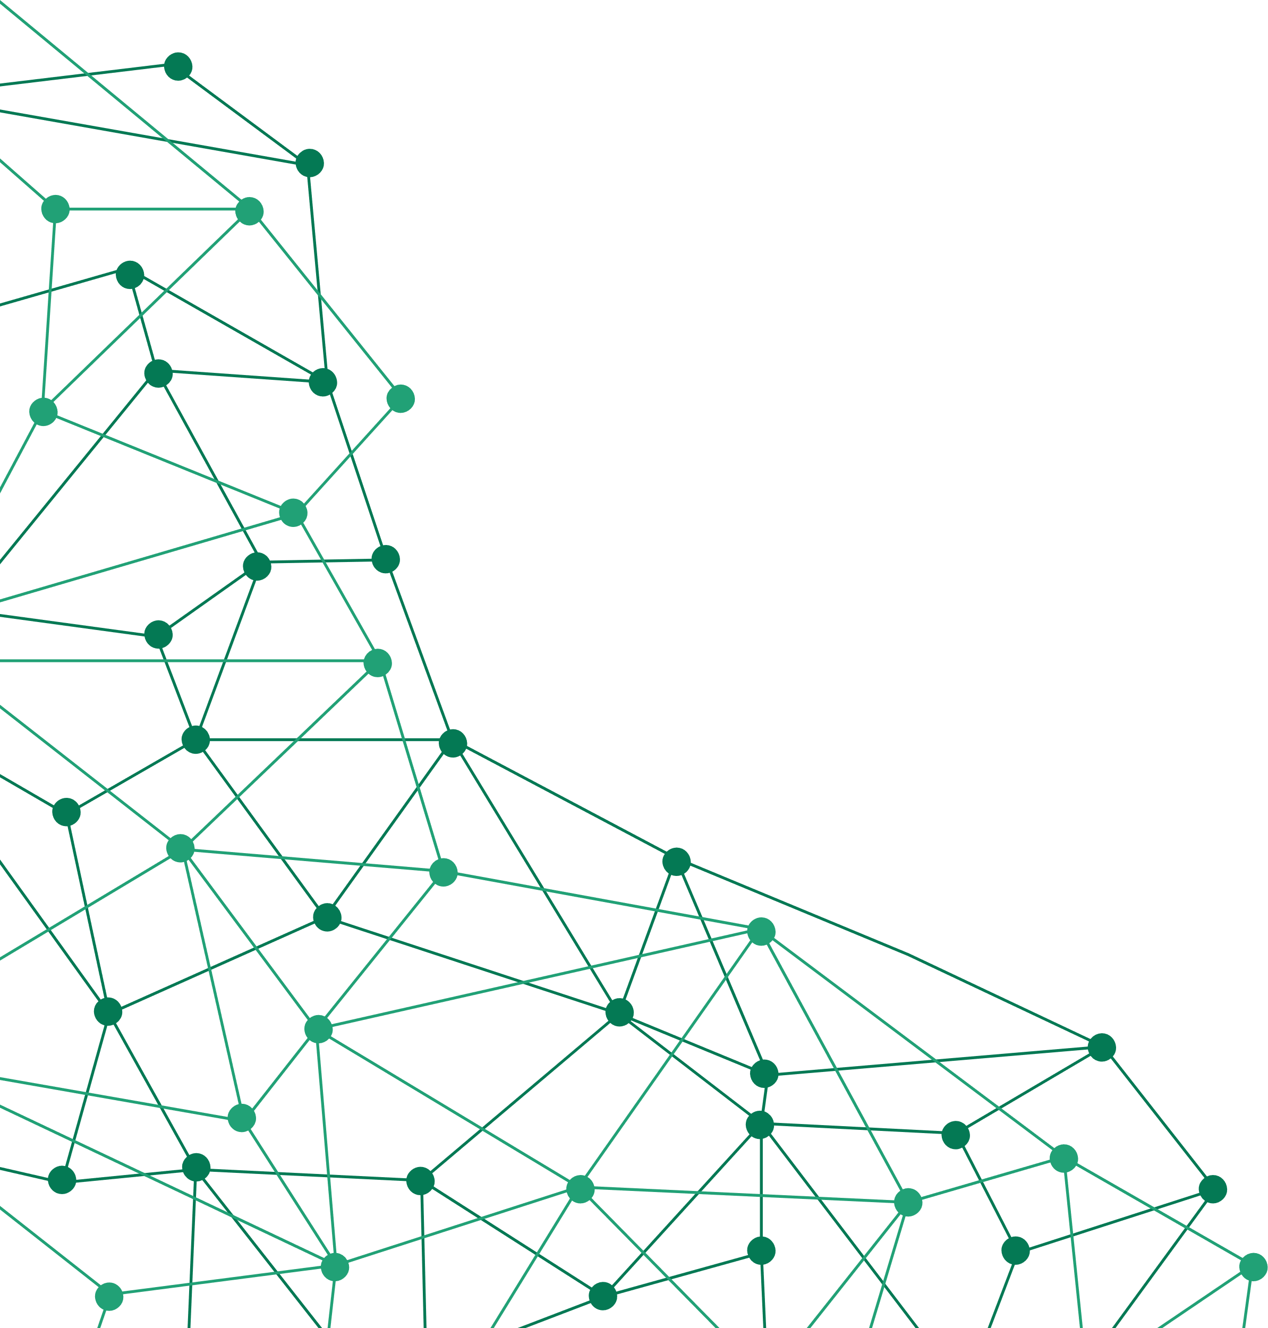
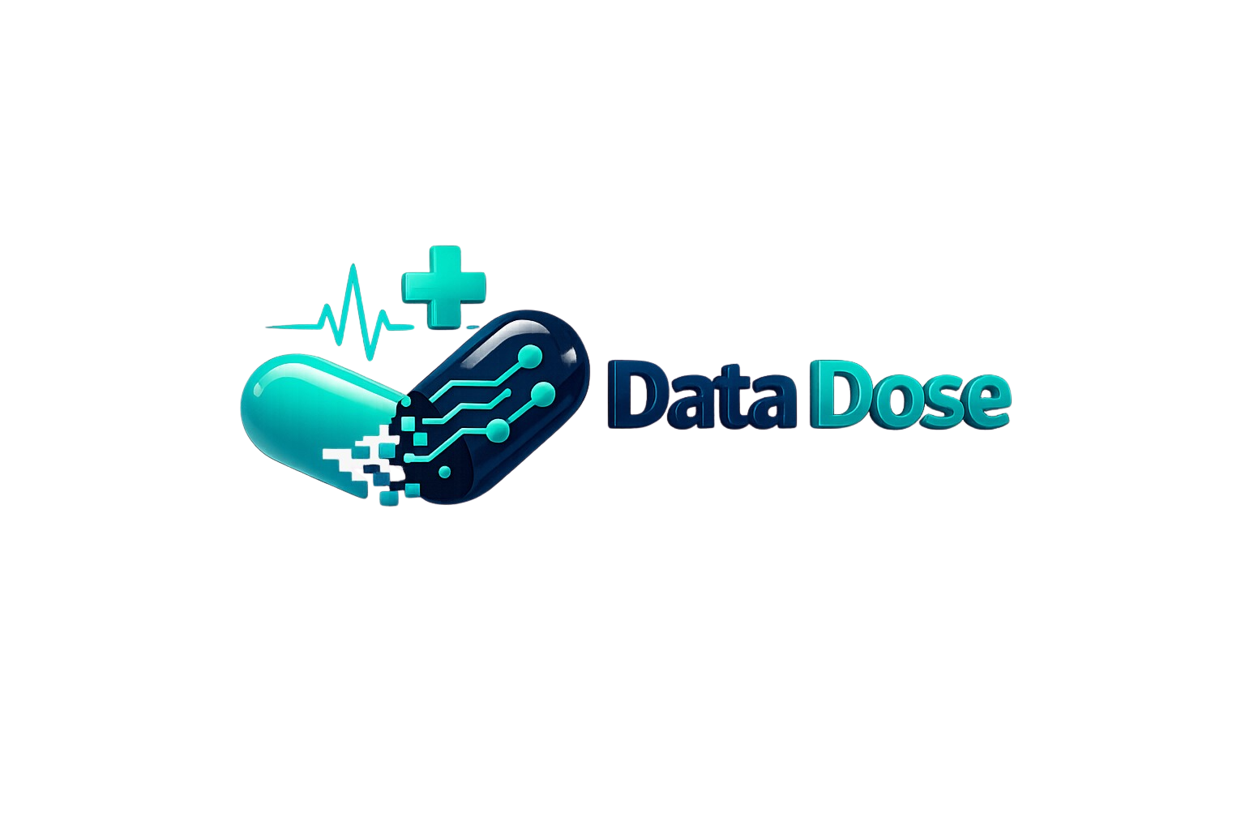



DataDose
AI-Powered Clinical Decision Intelligence Platform
Data Dose
June 26
07/15/26
1

Slide 2



Project Idea
Problem
Proposed solution
Unique Value
Patients receive multiple medications from different sources
Drug interactions are difficult to detect manually
Healthcare data is fragmented across systems
Late detection can cause harmful medication events
DataDose provides:
AI-powered drug safety platform
Real-time interaction scanning
Clinical knowledge graph
Intelligent healthcare analytics
Combines AI + Graph Database + Big Data Engineering
Supports doctors, pharmacists, and patients
End-to-end analytics pipeline
07/15/26
2

Slide 3
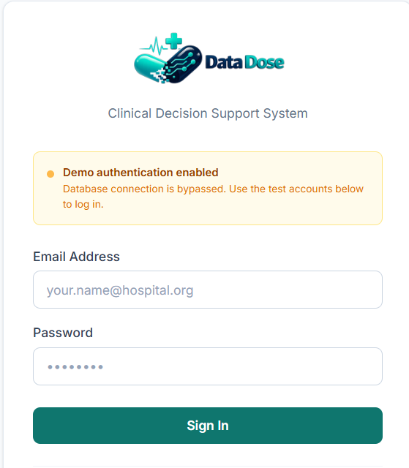
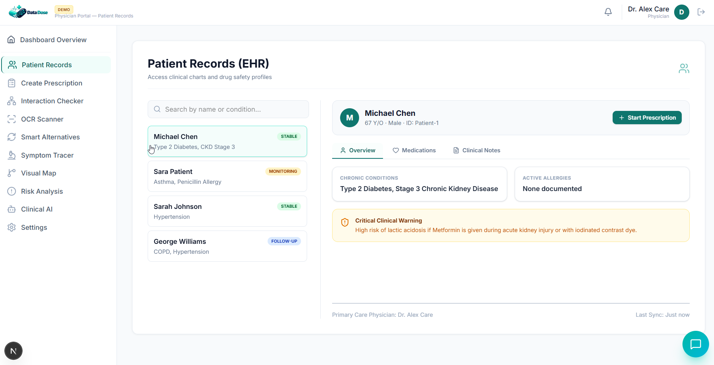
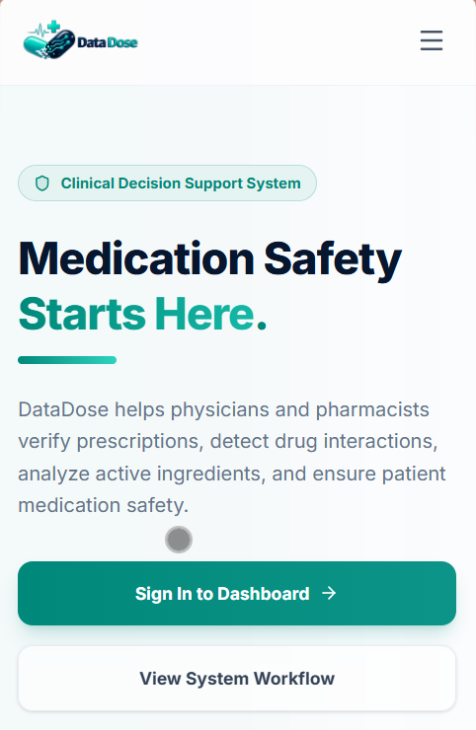
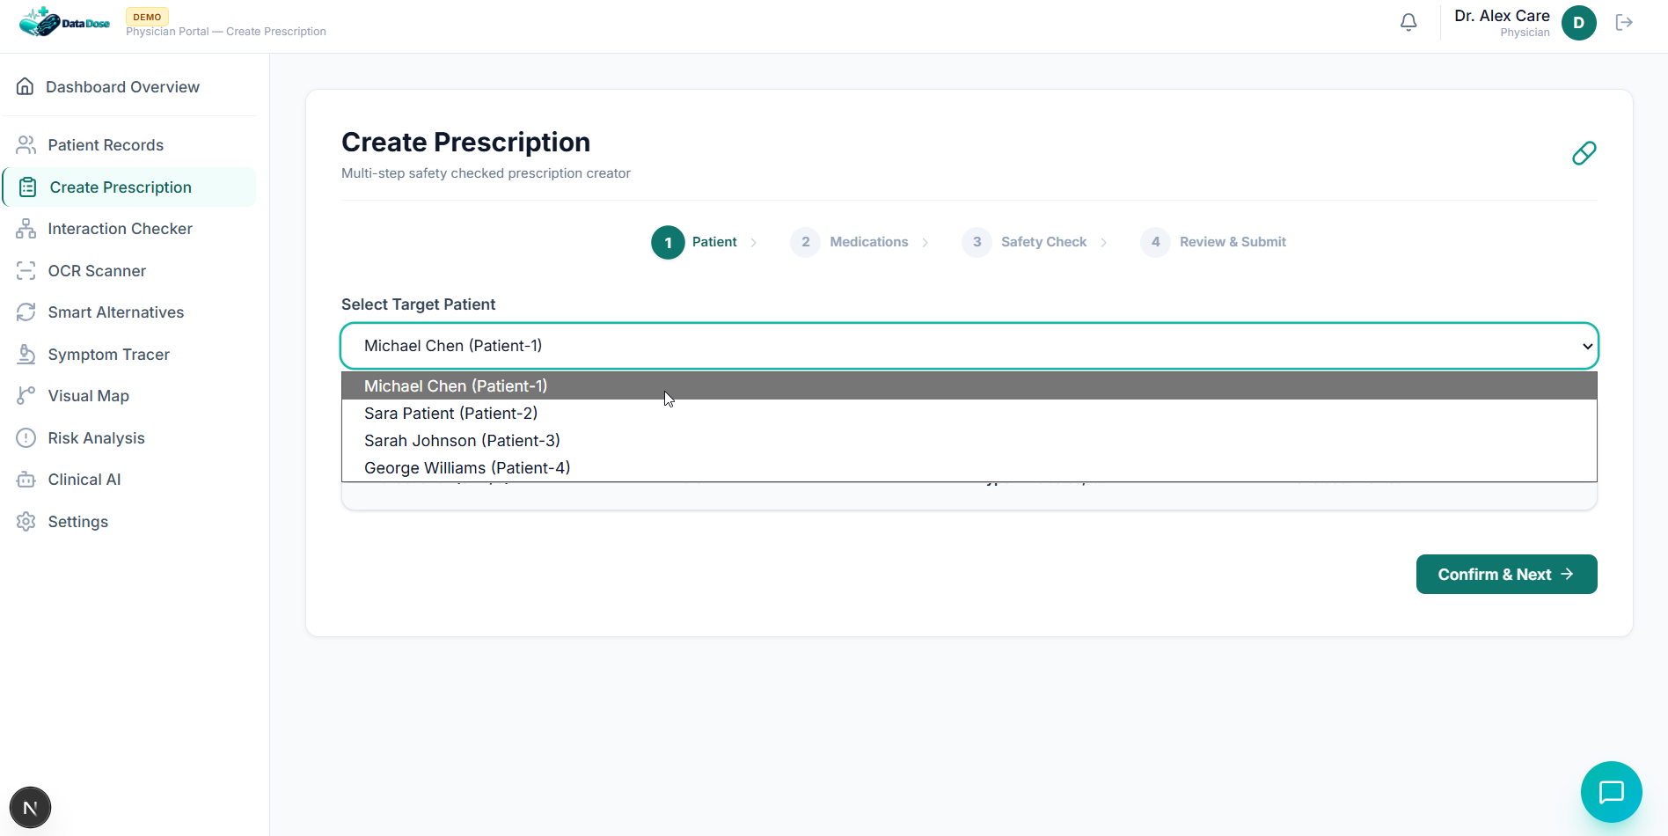
Project Wireframe
Physician Dashboard
07/15/26
3

Slide 4
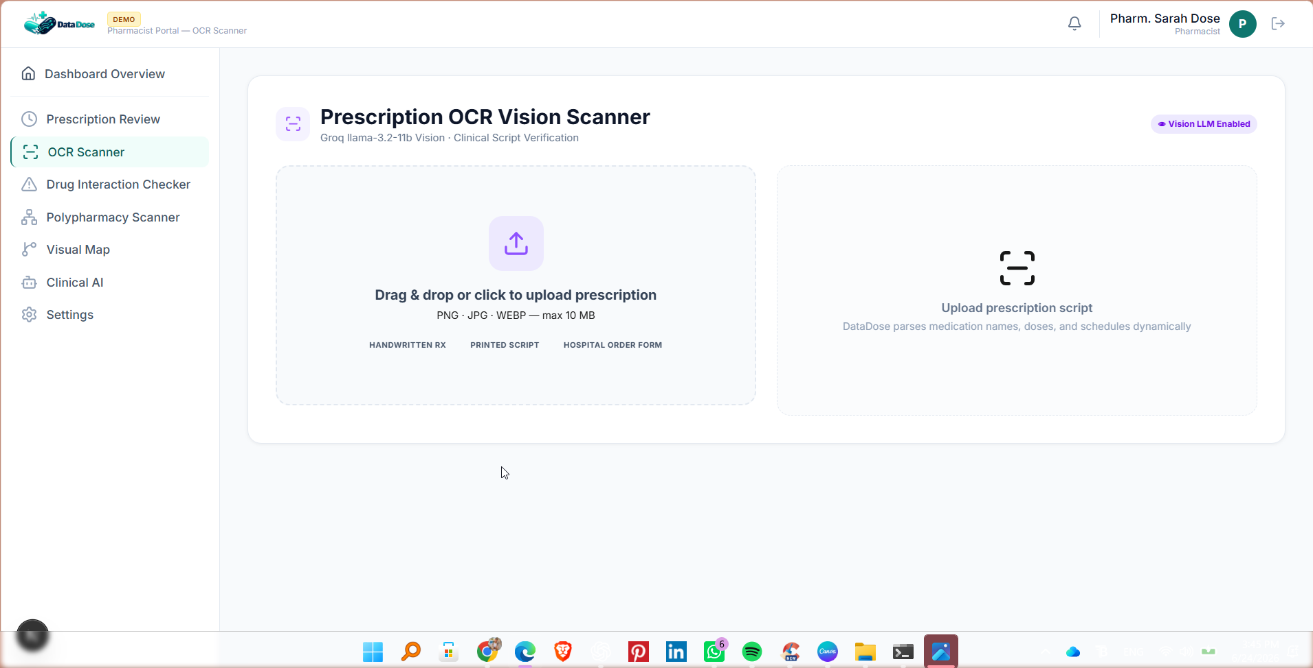
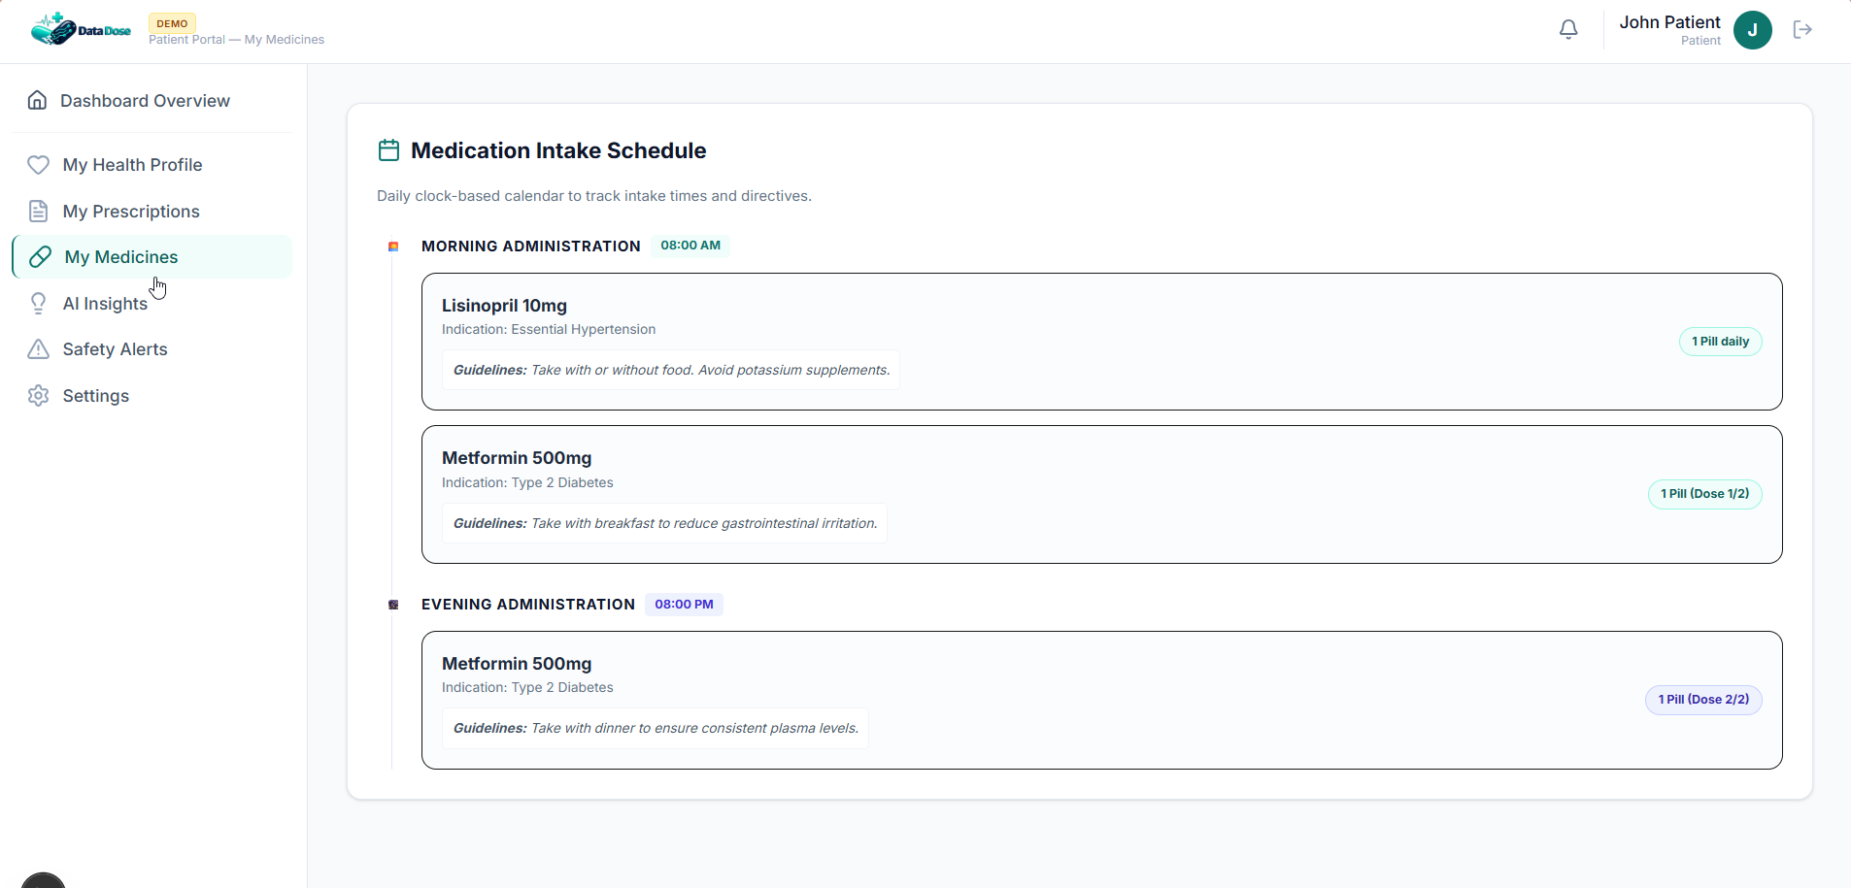
Project Wireframe
Pharmacist Dashboard
Patient Dashboard
07/15/26
4

Slide 5
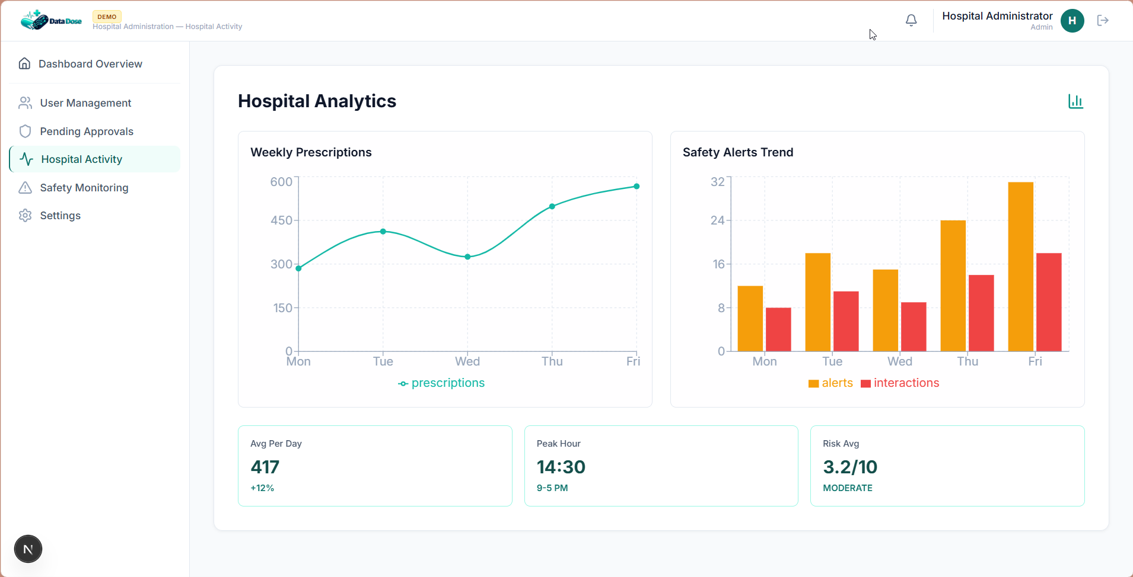
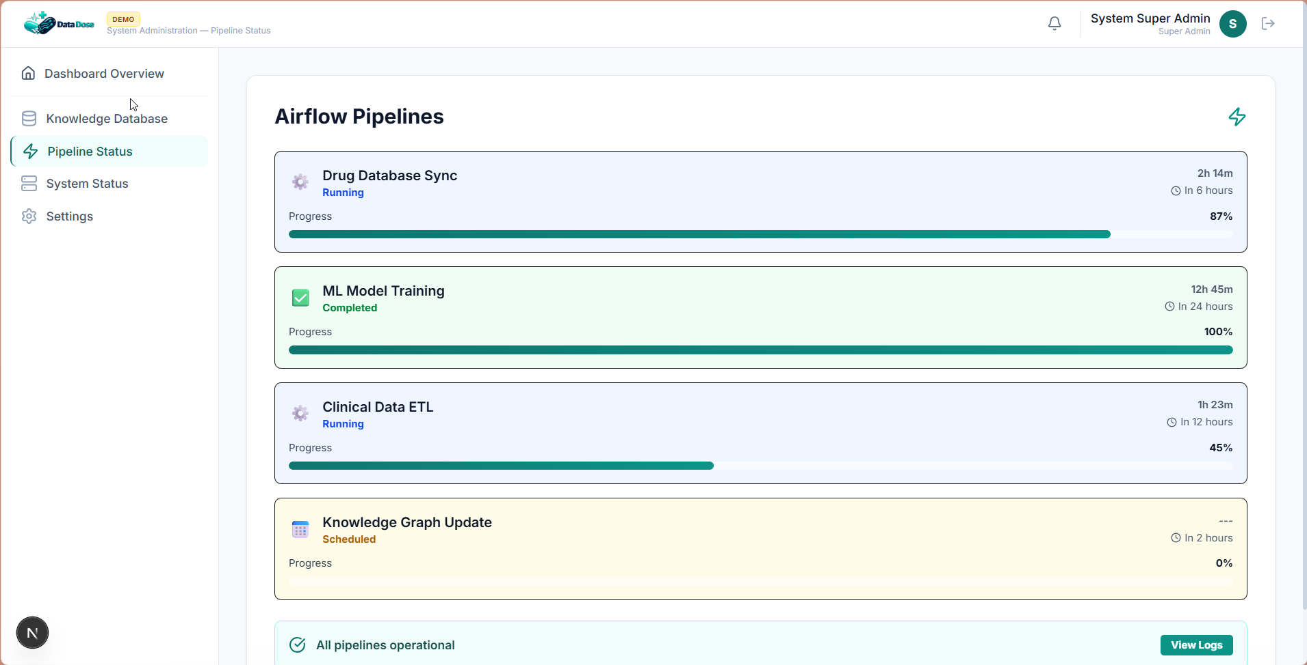
Project Wireframe
Hospital Administrator
System Super Admin
07/15/26
5

Slide 6
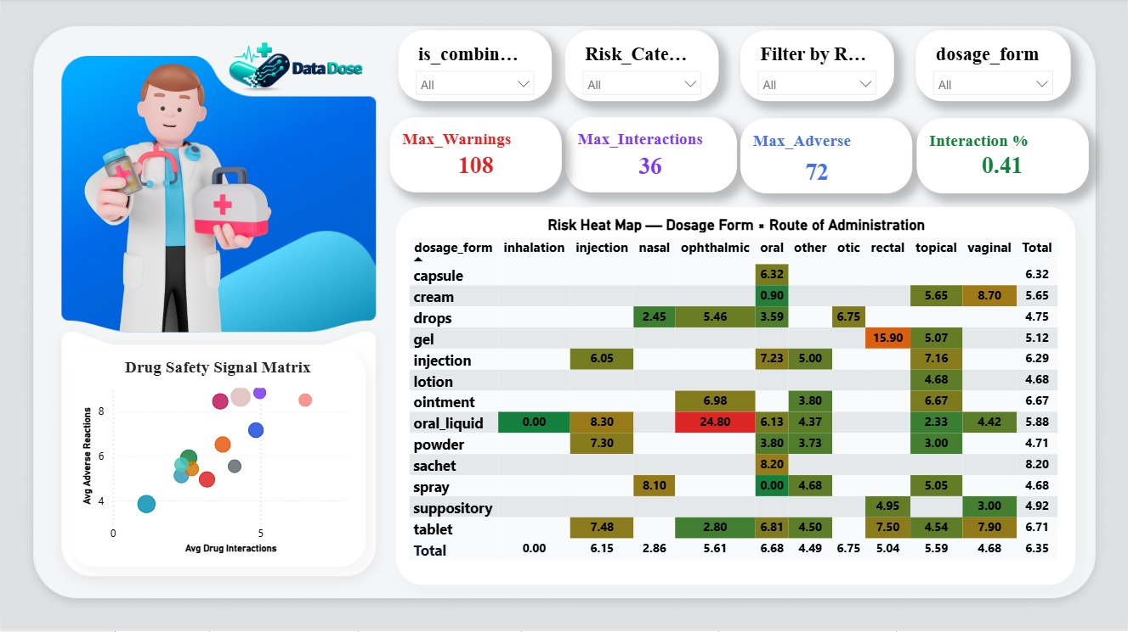
Project Dashboard
07/15/26
6

Slide 7
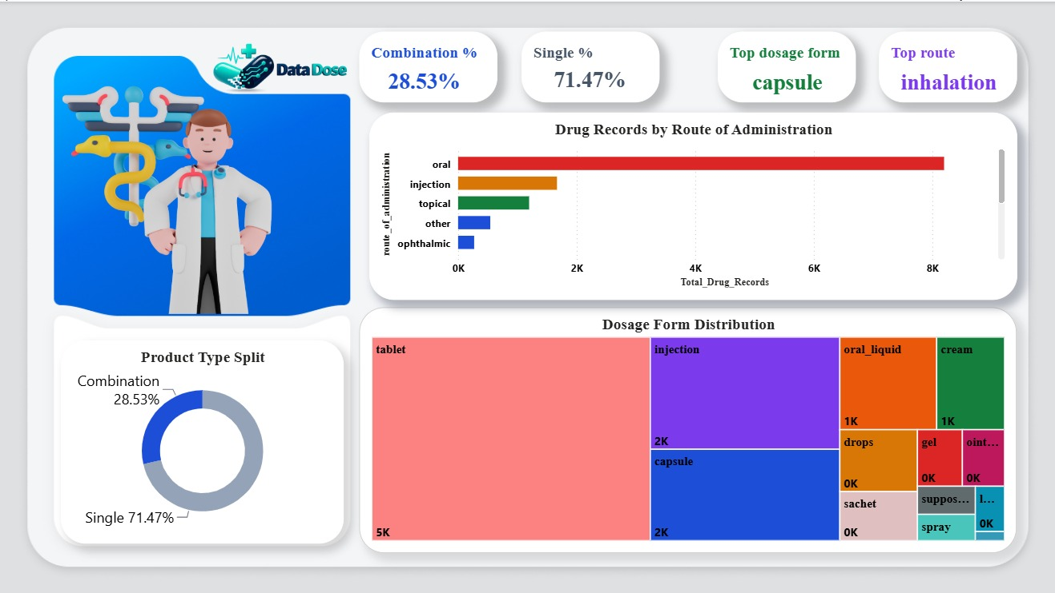
Project Dashboard
07/15/26
7

Slide 8





End Users + Features
Physicians
Pharmacists
Patient EHR
Prescription creation
Risk analysis
Prescription scanner
Drug interaction checker
Safety alerts
Manage
Patients
Admin
Medication tracking
AI assistant
Health insights
Analytics
User management
07/15/26
8

Slide 9
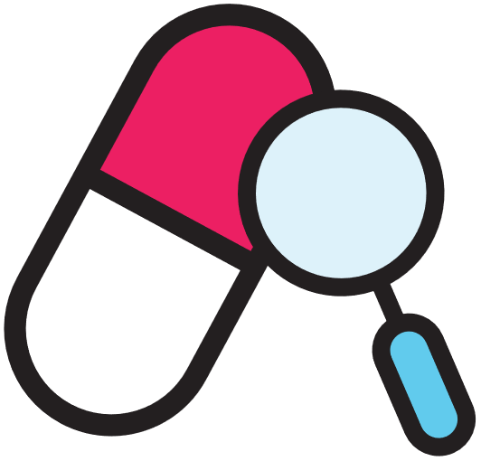

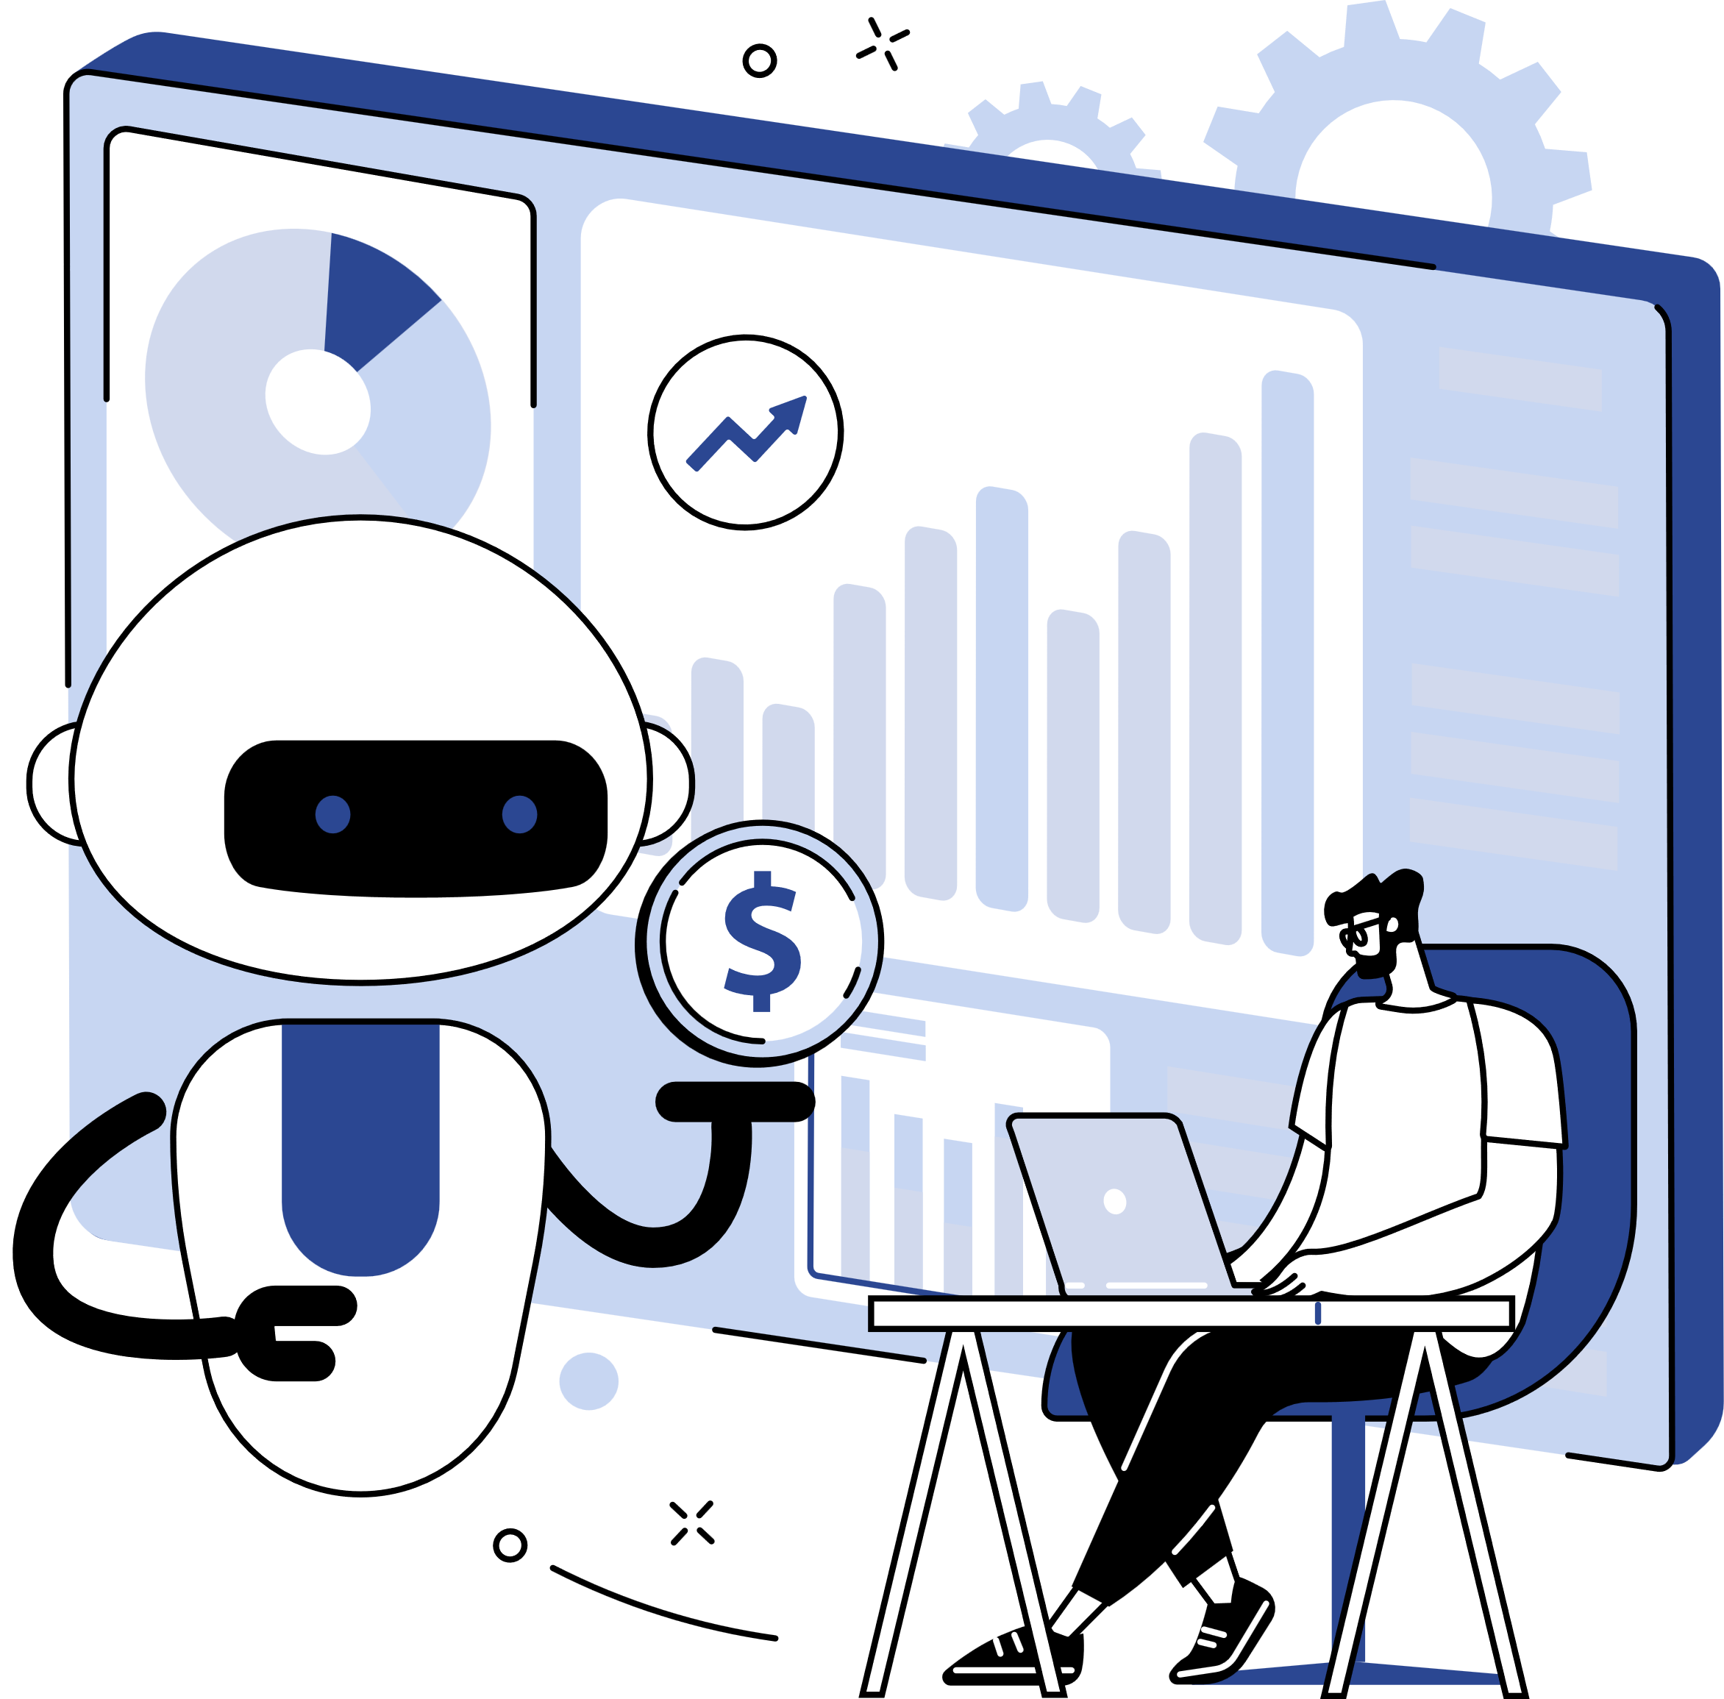

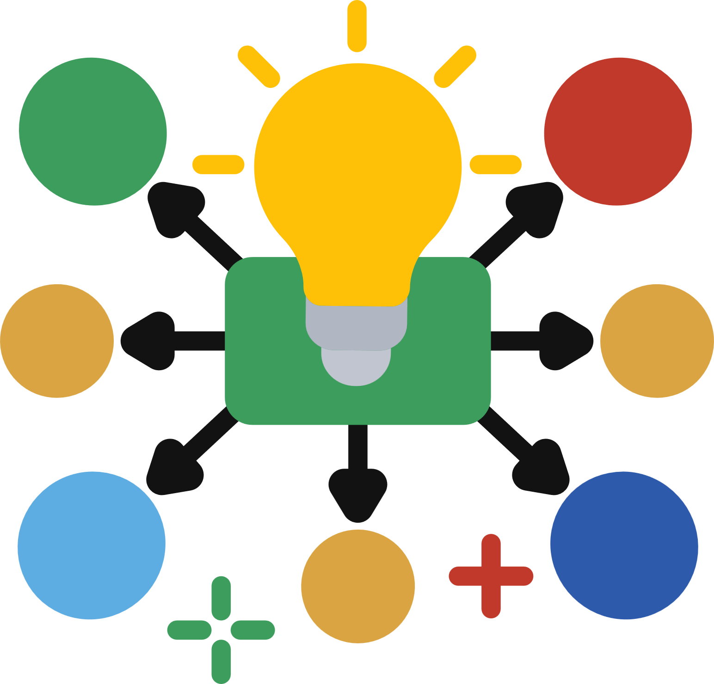
Core Features
Polypharmacy Scanner
Prescription OCR
Checks dangerous drug combinations instantly
Extracts medicines from prescription images
Smart Alternatives
GraphRAG Assistant
Suggest safer medication options
Visual Prescription Map
Suggest safer medication options
Interactive drug relationship graph
07/15/26
9

Slide 10
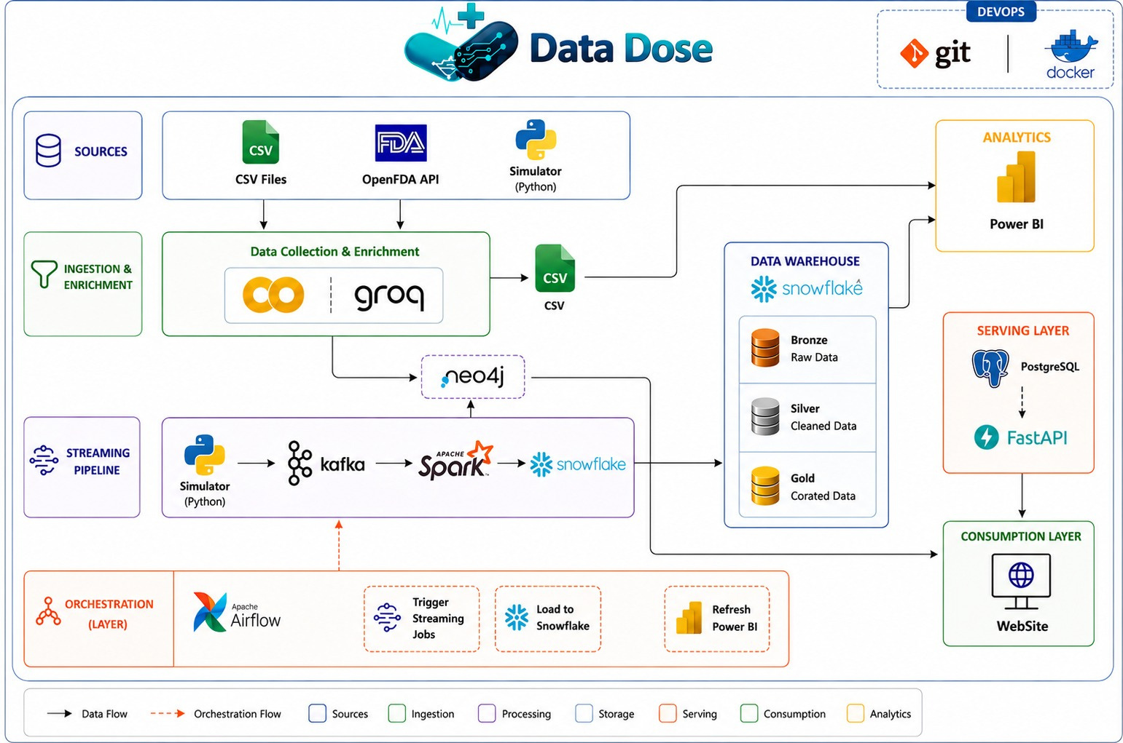
Pipleline
07/15/26
10

Slide 11

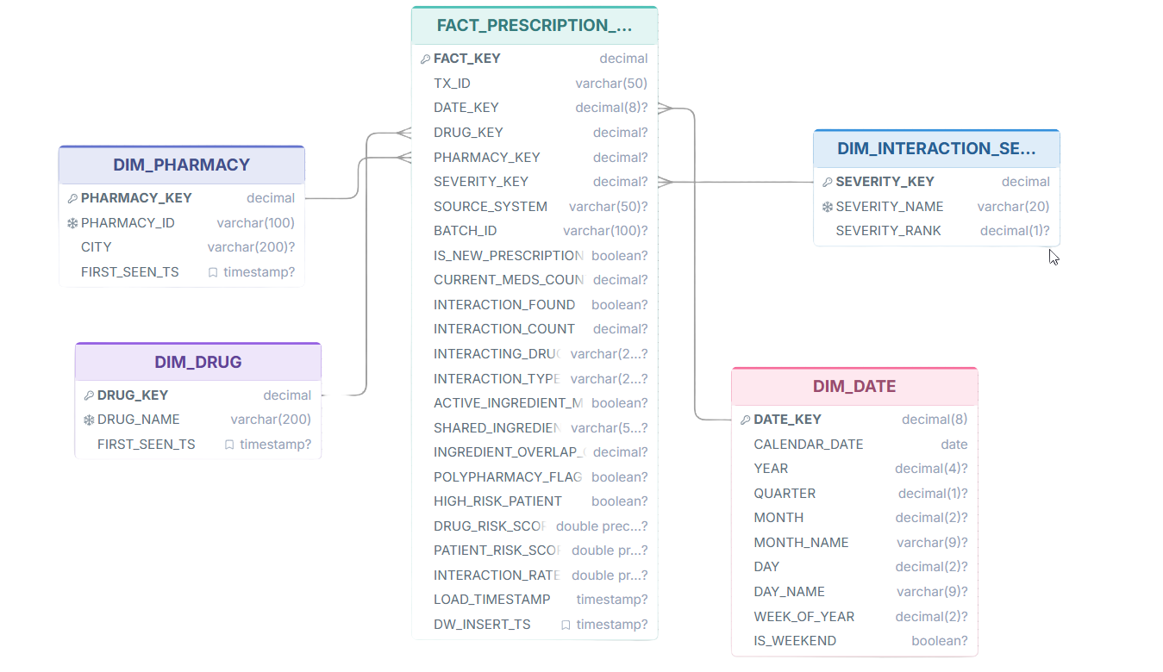
07/15/26
11

Slide 12
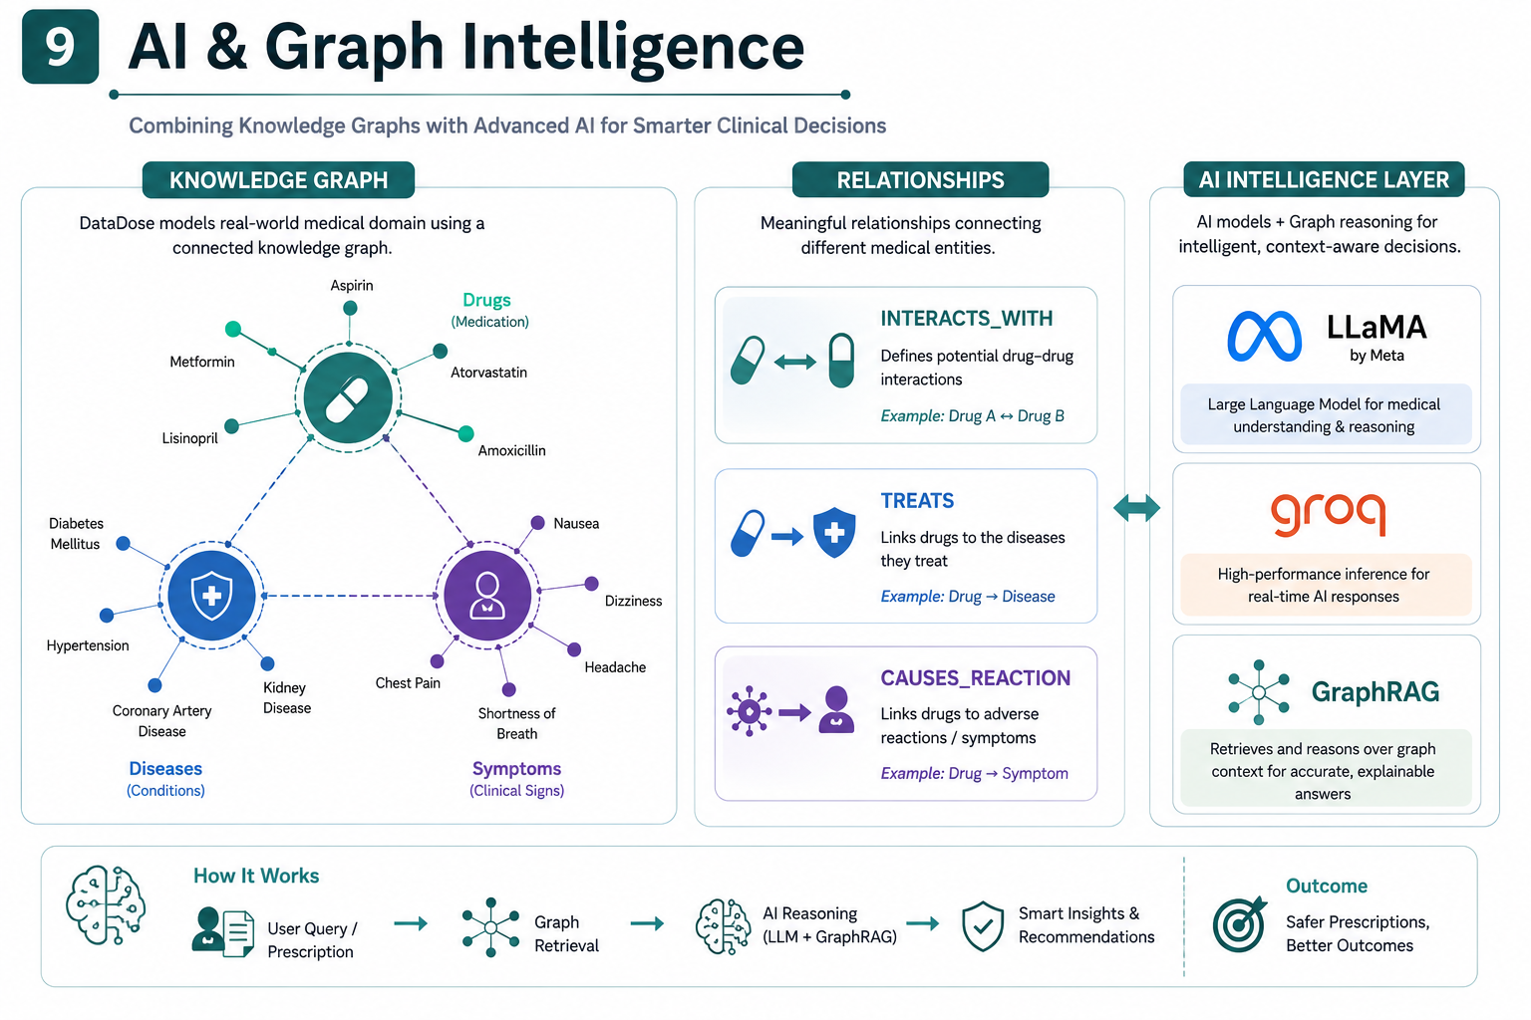
AI & Graph Intelligence
07/15/26
12

Slide 13
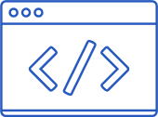
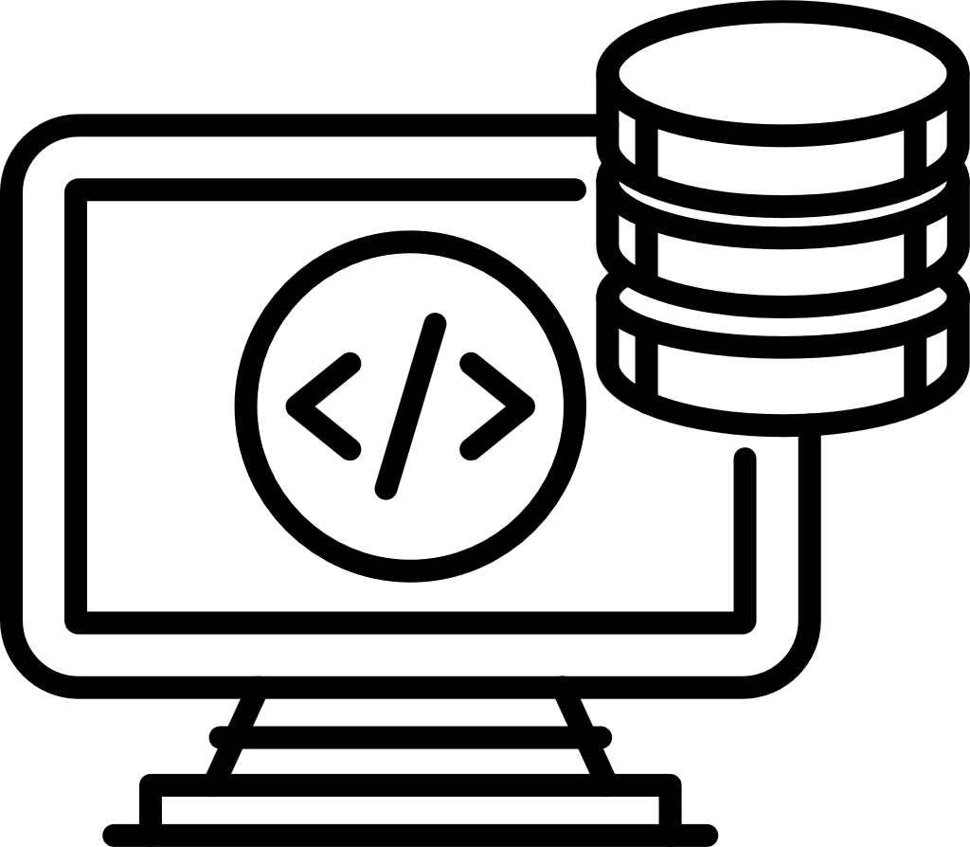
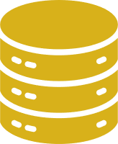
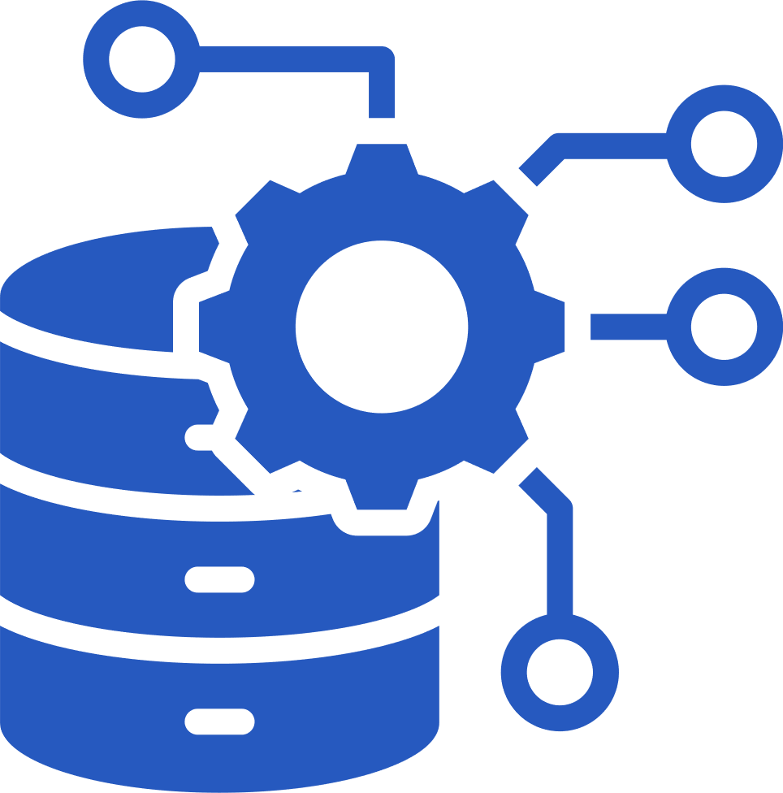
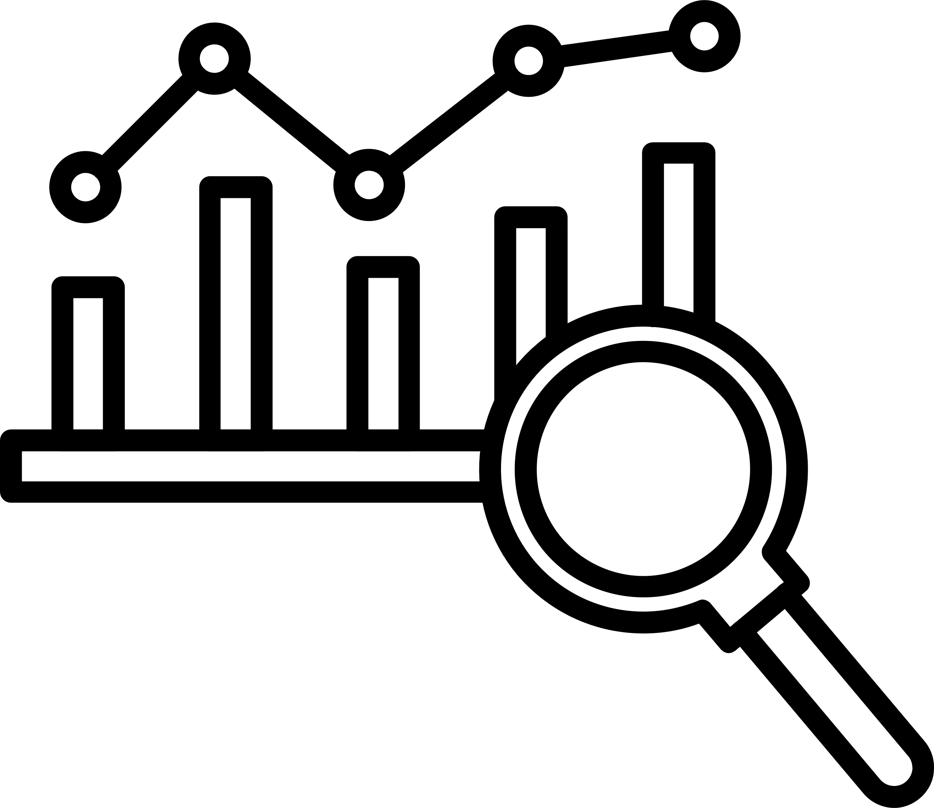

Technologies
Front-end
Back-end
Database
Next.js
React
TypeScript
Tailwind
FastAPI
Python
Neo4j
PostgreSQL
Data Engineering
Analytics
Artful Intelligence
Kafka
Databricks
PySpark
Snowflake
Power BI
Groq
LLaMA
07/15/26
13

Slide 14
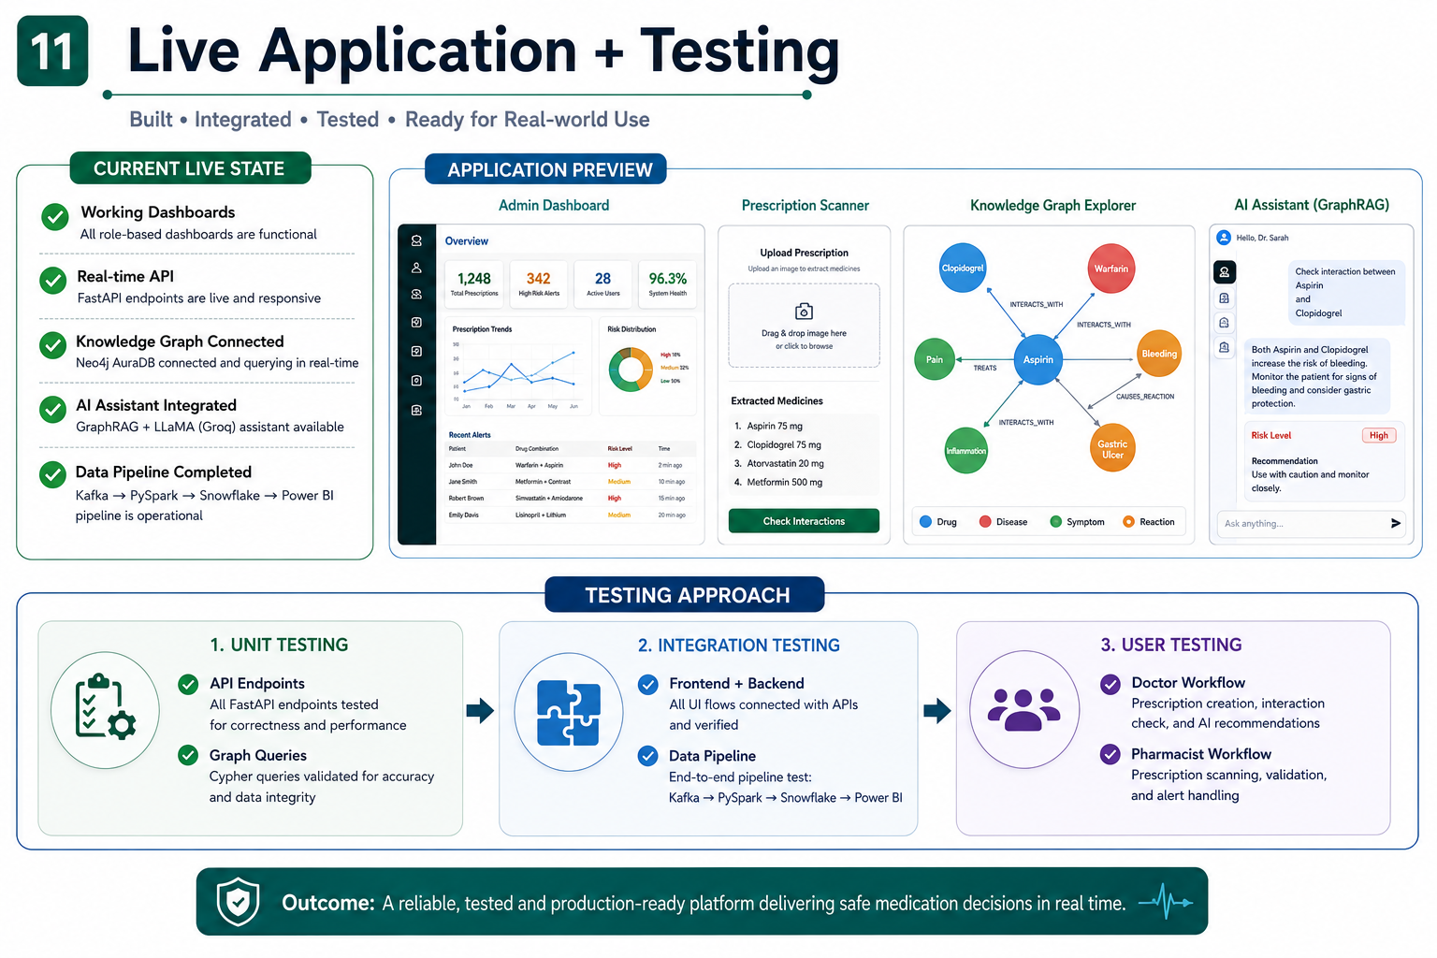
Live Application + Testing
07/15/26
14

Slide 15
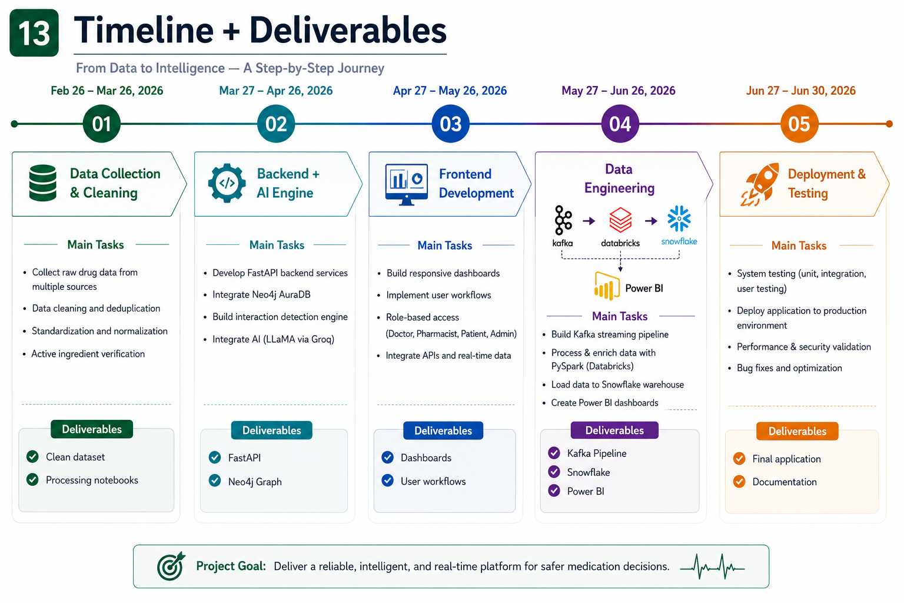
Timeline + Deliverables
07/15/26
15

Slide 16
Team
Youssef Adel
AmatAlrahman Sayed
Graph Database Designer • Full-Stack Developer
Simulation & DevOps Engineer
System architecture, Neo4j schema design, Backend APIs, Frontend development, Graph database integration
Prescription simulation engine, Kafka Producer, Docker containerization, Environment setup
Amr Ayman
Full-Stack Developer • Presentation Designer
Full-stack development, UI implementation, Presentation design, Demo video production
Mohamed Salah
Ali Gad
Data Engineer • BI Developer
Data Pipeline Engineer
Apache Kafka streaming, Snowflake data warehouse, Power BI dashboards, Data analytics
Apache Airflow orchestration, Apache Spark processing, ETL pipeline automation
07/15/26
16

Slide 17

DataDose
Making medication safety smarter, faster, and more intelligent.
DataDose Links
https://datadoseinfo.lovable.app
Thank you
07/15/26
17

